Slide 1

ELEC5620M-Embedded Microprocessor System Design Mini-Project – Tic Tac Toe
Name: Yucheng Lin
Student ID: 201580282
Notes:
Hi, im Yucheng Lin. The mini project is to create a game, Tic Tac Toe.

Slide 2
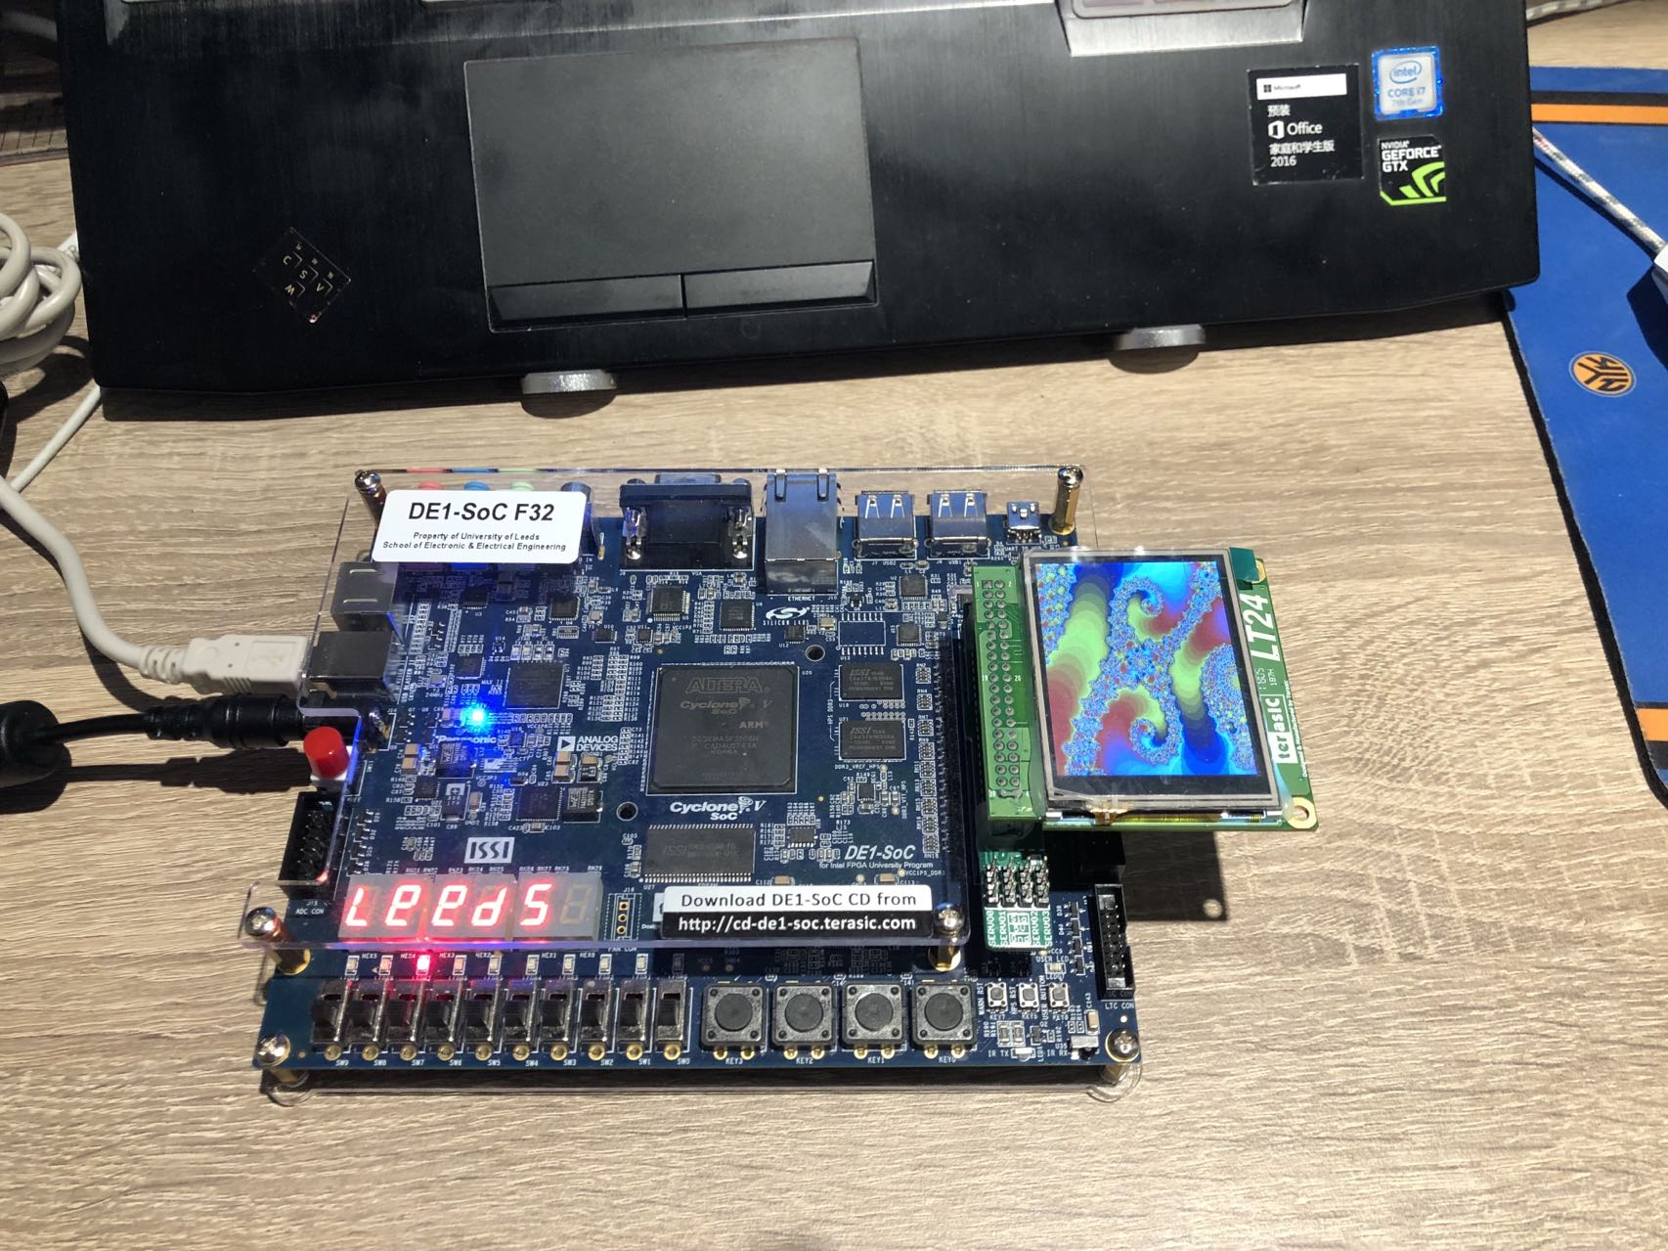
Mini-Project
LT24 LCD module
Introduction
Game Rules
Testing & Result
Conclusion
DE1-SoC Board
Notes:
The aim is to program the DE1-SoC development board and the LT24 LCD module. The presentation was divided into four parts: introduction, Game rules, testing and conclusion. In Figure, that part is the DE1-SoC board and the smaller one is the LT24 LCD module.

Slide 3
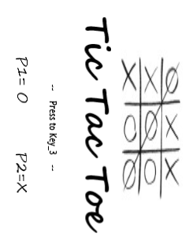
Introduction - Tic Tac Toe
DE1-SoC board
- Control and operating system
(LED, Switch, Key)
LT24 LCD module
- Displaying 240x320 images
Figure 1: The cover of game
Notes:
The tic-tac-toe game is controlled by the DE1 board, mainly using LED lights, switches and buttons. Then, the game screen is displayed on the LT24 LCD module according to the corresponding control, and only can display 240 by 320 images. On the right is the picture cover of the game.

Slide 4
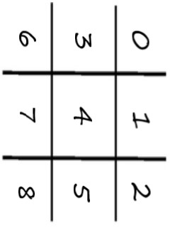


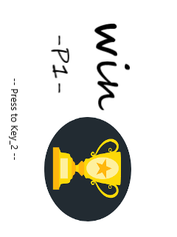

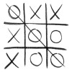

Game rules – 4 steps
1
2
Player 1 -
Start
Key_3
Player 2 -
Judge
3
4
Key_2
Reset
Result
Key_1
Notes:
Next are the rules of the game. There are four main steps. The first is the game cover, you can see that player 1 is a circle and player 2 is a cross. When you press button 3, the game starts. You can see the numbers on the nine squares, which correspond to the nine switches. Start with player 1, then player 2 and turn players around until the game is over. The third step is to judge who wins. If a player's circles or crosses form a line, the player wins. Finally, press Key_1 to see the results, with P1 wins or P2 wins or Tie. In addition, when pressing Key_2, the game is reset.

Slide 5
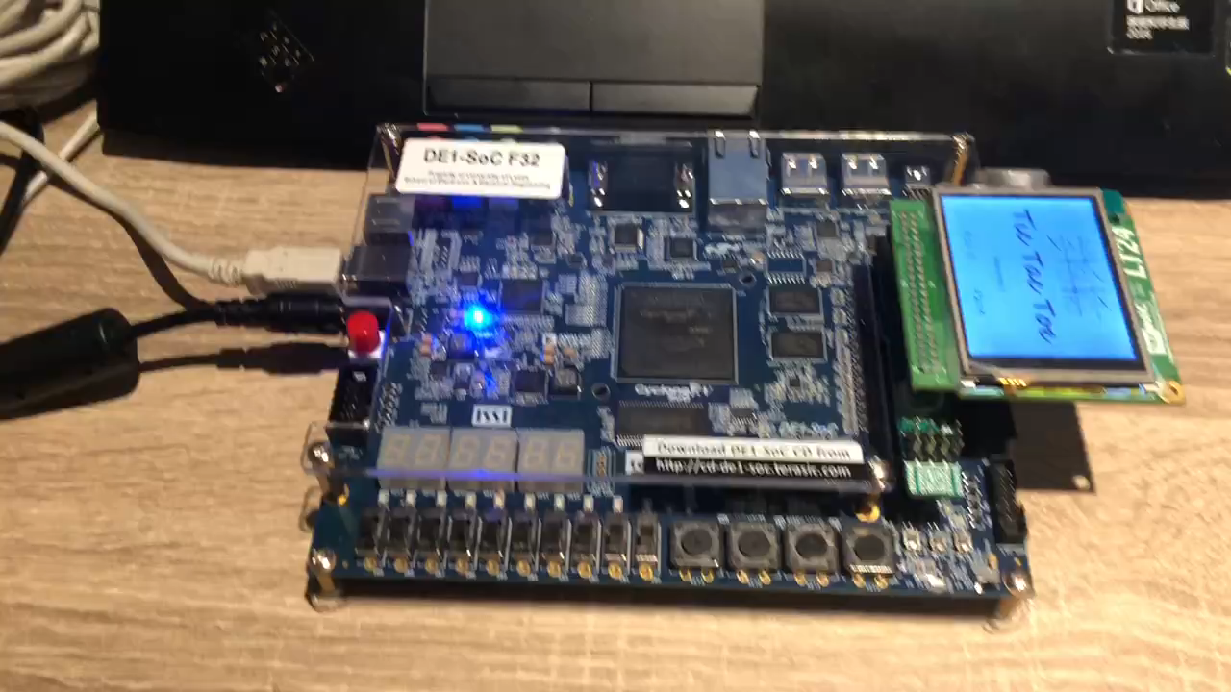
Testing & Result
Player 1
Wins

Slide 6
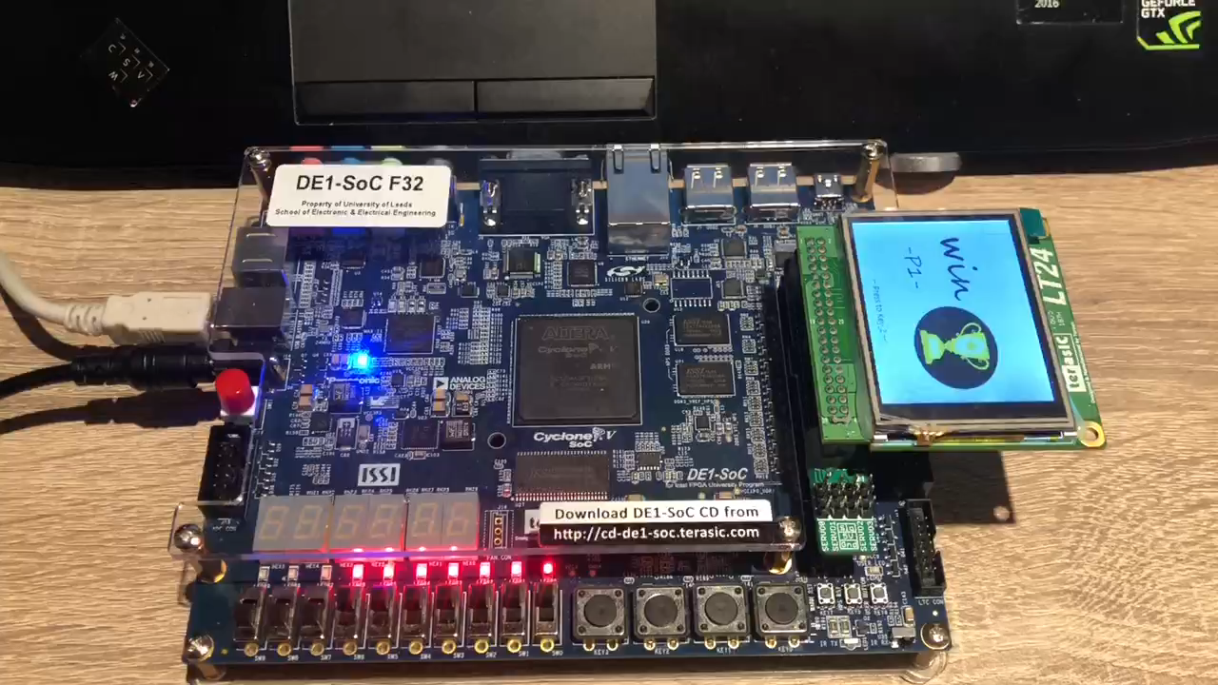
Player 2
Wins

Slide 7
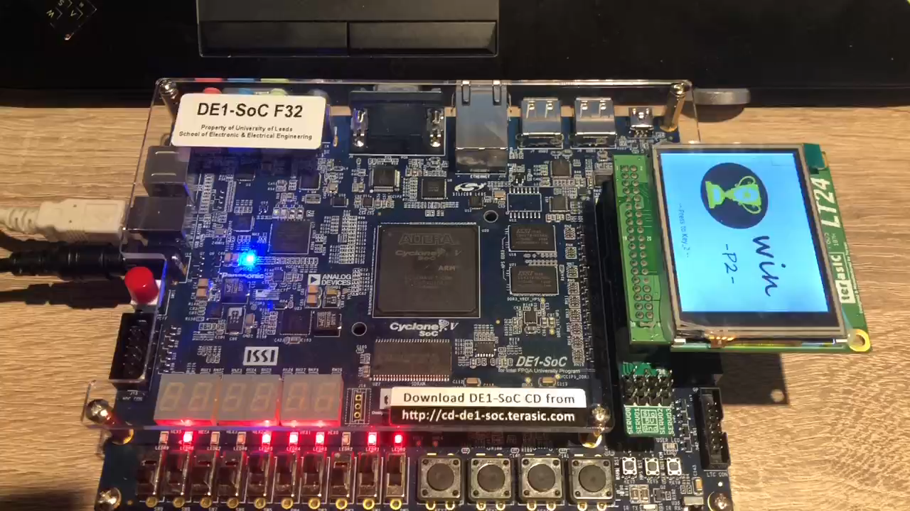
No one Win
Tie

Slide 8
Conclusion
Switching response problems
7-segment Display
Timer
Notes:
The whole game was created using the LT24 module, key, switches ,LED and the while function. The results of the tests were generally successful, although sometimes the switch did not immediately respond to the picture on the LT24, this did not affect the results. In the future, the game could be improved by adding a 7-segment display to show which player is currently playing, or by adding a timer to limit the game time.

Slide 9
Thank you

